Slide 1
RADIATION

Slide 2
What is Radiation
The most general definition is that radiation is energy that comes from a source and travels through some material or through space.
Light, heat, and sound are types of radiation. This is a very general definition, the kind of radiation discussed here is called ionizing radiation.
Most people connect the term radiation only with ionizing radiation, but it is not correct. Radiation is all around us. It is a natural energy force that surrounds us. It is a part of our natural world that has been here since the birth of our planet.

Slide 3
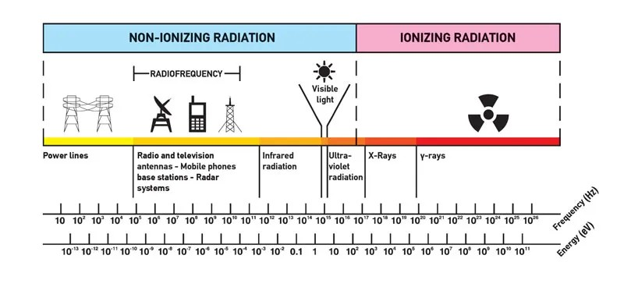
IONIZATION
Ionization, is a process by which electrically neutral atoms or molecules are converted to electrically charged atoms or molecules (ions) through gaining or losing electrons.

Slide 4
α and β particles
Alpha Particles
Alpha (α) is the largest particle with the least penetrative power. Alpha particles carry a positive charge. An alpha particle consists of two neutrons and two protons bound together. The alpha particle later got identified as the helium-4 nucleus.
Alpha particles have the greatest mass among the three types of radioactive emissions. The mass of an alpha particle is about 8000 times more than the mass of a beta particle. This large size reduces the penetrative power of an alpha particle.
Beta Particles
Beta particles (β) are high-energy electrons or positrons that carry a negative charge. Considerably smaller in size than alpha particles, beta particles have higher penetrative power.

Slide 5
Gamma(γ)rays
Gamma rays (γ) are not particles with a mass. They are a kind of electromagnetic radiation that is considerably higher in energy than x-rays. As a form of energy, gamma rays have no size or mass.
Gamma rays are far more harmful to humans than x-rays. The charge of gamma rays, however, is neutral.
(X-rays and gamma rays have the same basic properties but come from different parts of the atom. X-rays are emitted from processes outside the nucleus, but gamma rays originate inside the nucleus. They also are generally lower in energy and, therefore less penetrating than gamma rays)

Slide 6

Exposure to α particles

Slide 7

Exposure to β particles
Exposure to γ and X Rays

Slide 8
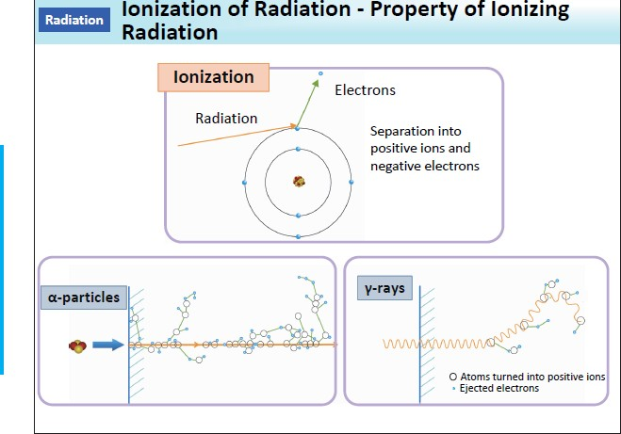

Slide 9
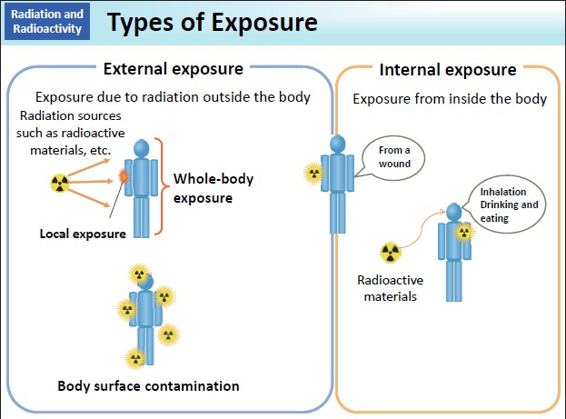

Slide 10
Ionizing radiation has different ionization mechanisms and may be grouped as:
Directly ionizing. Charged particles (atomic nuclei, electrons, positrons, protons, muons, etc.) can ionize atoms directly through fundamental interaction through the Coulomb force if they carry sufficient kinetic energy.
Alpha radiation. Alpha radiation consists of alpha particles at high energy/speed. The production of alpha particles is termed alpha decay.
Beta radiation. Beta radiation consists of free electrons or positrons at relativistic speeds. The production of beta particles is termed beta decay.

Slide 11
Distinguish between Non-Ionizing and Ionizing Radiation
Non-ionizing radiation. The kinetic energy of particles (photons, electrons, etc.) of non-ionizing radiation is too small to produce charged ions when passing through matter. The particles (photons) have sufficient energy to change the rotational, vibrational, or electronic valence configurations of target molecules and atoms. Sunlight, radio waves, and cell phone signals are examples of non-ionizing (photon) radiation. However, it can still cause harm, like when you get a sunburn.
Ionizing radiation. The kinetic energy of particles (photons, electrons, etc.) of ionizing radiation is sufficient, and the particle can ionize (to form ion by losing electrons) target atoms to form ions. Simply ionizing radiation can knock electrons from an atom.

Slide 12
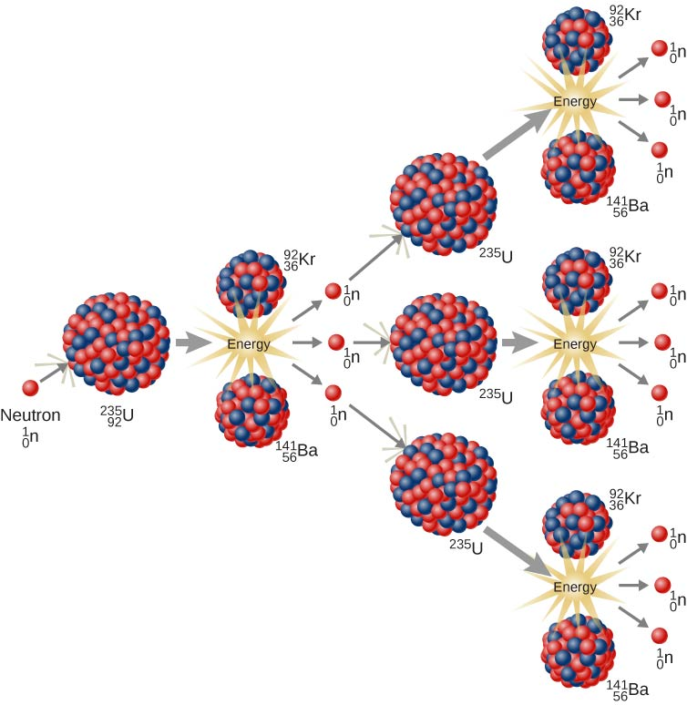
Indirectly ionizing. Indirect ionizing radiation is electrically neutral particles and therefore does not interact strongly with matter.
Photon radiation (Gamma rays or X-rays). Photon radiation consists of high- energy photons. According to the currently valid definition, X-rays are emitted by
electrons outside the nucleus, while the nucleus emits gamma rays. The production of gamma rays is termed gamma decay.
Neutron radiation. Neutron radiation consists of free neutrons at any energies/speeds. This type of radiation can be produced by nuclear reactors or in flight.
Neutrons contribute 40 – 80% of the equivalent dose.

Slide 13
There are three main types of radiation detectors, which record different types of signals.
Counter. The activity or intensity of radiation is measured in counts per second (cps).
Radiation Spectrometer. Spectrometers are devices designed to measure the spectral power distribution of a source.
Dosimeter. A radiation dosimeter is a device that measures exposure to ionizing radiation.
In general, there are two broad categories of radiation sources:
Natural Background Radiation. Natural background radiation includes radiation produced by the Sun, lightning, primordial radioisotopes or supernova explosions, etc.
Man-Made Sources of Radiation. Man-made sources include medical uses of radiation, residues from nuclear tests, industrial uses of radiation, etc.

Slide 14
Effects of radiation on Human body
The Incredible Hulk, Daredevil, the Flash … what do all of these superheroes have in common? They all got their powers through radiation!
In real life, exposure to radiation can cause all kinds of effects. Unfortunately, scientists have learned that gaining superpowers is not one of them. Instead, effects can range from mild burns to lethal cancers

Slide 15
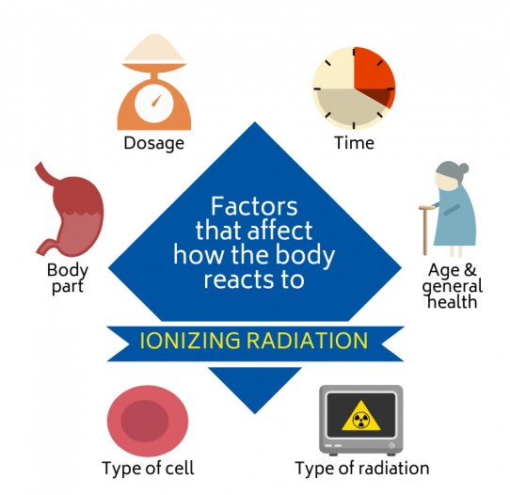
Several factors affect how the human body reacts to ionizing radiation.
These include:
The dosage (amount of radiation received).
The time over which the dose is received.
The cells that are affected.
The part of the body that is affected.
The type of radiation.
The age and general health of the person.

Slide 16
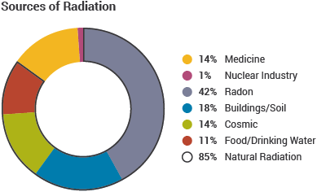
What is a lethal dose of radiation?
Scientists calculate the lethal dose of radiation using the number of expected deaths over a period of time after the exposure.
Ionizing radiation is measured with a Geiger counter in units called Sieverts. A lethal dose of ionizing radiation is expected to cause 50 percent of an exposed population to die within 30 days following the exposure. A lethal dose is about 4-5 sieverts. In Canada, the recommended limit of exposure to ionizing radiation is one millisievert per year, or 0.001 sieverts. That’s 4000 times lower than a lethal dose!
Very high doses of radiation do not tend to result in immediate death. However, they can result in skin burns, hair loss, vomiting, sterility,cancers and cataracts (clouding of the lens of the eye)

Slide 17
What are the acute effects of radiation exposure?
High doses of radiation over short periods of time produce acute (severe), short- term effects. High doses of radiation tend to kill cells. This damages tissues and organs. All of this can lead to a whole body response called Acute Radiation Syndrome (ARS). ARS can end in death.
People can be exposed to high doses of radiation in a few different ways. Examples include nuclear weapon explosions, nuclear reactor accidents and workplace accidents.

Slide 18
What are the chronic effects of radiation exposure?
Low doses of radiation over long periods of time can produce chronic (long-term) effects. Low doses do not tend to cause immediate problems to tissues and organs.
But over the long term, they can damage or alter the genetic code (DNA mutations). This damage can happen in both gametes and somatic cells. Gametes are reproductive cells. DNA mutations in gametes can be inherited by children. These children might grow or develop at slower rates. Somatic cells are non-reproductive cells. Mutations in somatic cells can cause cancer.

Slide 19
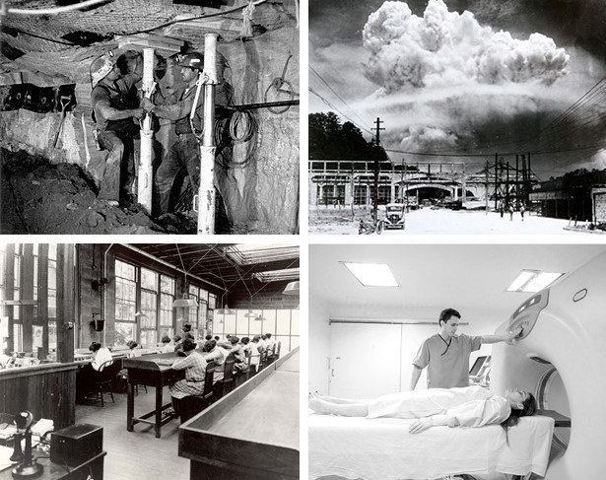
Radiation is an example of a physical carcinogen (cancer-causing agent). Many studies have linked cancer with occupational or accidental exposure to radiation. Some examples include:
Lung cancer in uranium miners.
Leukemia (blood cancer) in atomic bomb survivors
Bone cancer in radium dial (glowing part in wrist watches).
Skin cancer in radiologists
Radiologists are medical doctors that specialize in diagnosing and treating injuries and diseases using medical imaging (radiology) procedures (exams/tests) such as X-rays, computed tomography (CT), magnetic resonance imaging (MRI), nuclear medicine, positron emission tomography (PET) and ultrasound.

Slide 20
Radiation Biology
All biological damage effects begin with the consequence of radiation interactions with the atoms forming the cells. There are two mechanisms by which radiation ultimately affects cells. These two mechanisms are commonly called:
Direct effects. Direct effects are caused by radiation, when radiation interacts directly with the atoms of the DNA molecule, or some other cellular component critical to the survival of the cell. The probability of the radiation interacting with the DNA molecule is very small since these critical components make up such a small part of the cell.
Indirect effects. Indirect effects are caused by interaction of radiation usually with water molecules. Each cell, just as is the case for the human body, is mostly water. Ionizing radiation may break the bonds that hold the water molecule together, producing radicals such as hydroxyl OH, superoxide anion O₂–and others. These radicals can contribute to the destruction of the cell.

Slide 21
A large number of cells of any particular type is called a tissue. If this tissue forms a specialised functional unit, it is called an organ. The type and number of cells affected is also an important factor. Some cells and organs in the body are more sensitive to ionizing radiation than others.
Sensitivity of various types of cells to ionizing radiation is very high for tissues consisting of cells that divide rapidly like those found in bone marrow, stomach, intestines, male and female reproductive organs, and developing fetuses.
Living cells can be classified according to their rate of reproduction, which also indicates their relative sensitivity to radiation. As a result, actively reproducing cells are more sensitive to ionizing radiation than cells that make up skin, kidney or liver tissue. The nerve and muscle cells are the slowest to regenerate and are the least sensitive cells.

Slide 22
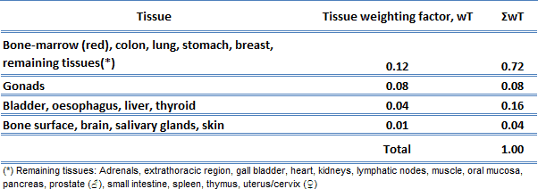
The sensitivity of the various organs of the human body correlate with the relative sensitivity of the cells from which they are composed.
In practice, this sensitivity is represented by the tissue weighting factor, w_{T}, which is the factor by which the equivalent dose in a tissue or organ T is weighted to represent the relative contribution of that tissue or organ to the total health detriment resulting from uniform irradiation of the body.
If a person is irradiated only partially, the dose will depend strongly on the tissue, which was irradiated. For example, a 10 mSv gamma dose to the whole body and a 50 mSv dose to the thyroid is the same, in terms of risk, as a whole-body dose of 10 + 0.04 x 50 = 12 mSv.

Slide 23
Penetrating Power of Radiation
With all the radiation from natural and man-made sources, we should quite reasonably be concerned about how all the radiation might affect our health. The damage to living systems is done by radioactive emissions when the particles or rays strike tissue, cells, or molecules and alter them.
These interactions can alter molecular structure and function; cells no longer carry out their proper function and molecules, such as DNA, no longer carry the appropriate information. Large amounts of radiation are very dangerous, even deadly. In most cases, radiation will damage a single (or very small number) of cells by breaking the cell wall or otherwise preventing a cell from reproducing.

Slide 24
These have different physical characteristics and biological effectiveness in causing tissue damage.
Gamma radiation and X-rays are electromagnetic radiation like visible light, radio waves, and ultraviolet light. These electromagnetic radiations differ only in the amount of energy they have. Gamma radiation is able to travel many metres in air and many centimetres in human tissue. It readily penetrates most materials and is sometimes called "penetrating radiation." Radioactive materials that emit gamma radiation and X-rays constitute both an external and internal hazard to humans. Dense materials are needed for shielding from gamma radiation. Clothing and turnout gear provide little shielding from penetrating radiation but will prevent contamination of the skin by radioactive materials.
Beta radiation consists of sub atomic particles (electrons) ejected from a radioactive atom. Beta radiation may travel metres in air and is moderately penetrating. Beta radiation can penetrate human skin to the "germinal layer," where new skin cells are produced. If beta-emitting contaminants are allowed to remain on the skin for a prolonged period of time, they may cause skin injury. Beta-emitting contaminants may be harmful if deposited internally and clothing and turnout gear provide some protection against most beta radiation. Turnout gear and dry clothing can keep beta emitters off of the skin.

Slide 25
Alpha radiation consists of specific particles ejected from some radioactive atom. Alpha particles are essentially helium nuclei. They have low penetrating power and short range. Alpha radiation is not able to penetrate skin, but they can be harmful to humans if the materials are inhaled, swallowed, or absorbed through open wounds. Alpha radiation is not able to penetrate turnout gear, clothing, or a cover on a probe.
Neutrons are uncharged sub atomic particles produced by the fission of radioactive atoms. Within tissue, neutrons predominantly lose energy in collisions with protons in the nuclei of hydrogen atoms, in body water. The interaction results in ionisation within the tissue atoms so irradiated. Except at lethal levels the neutron flux is not sufficiently high to cause the tissue to become radioactive.

Slide 26
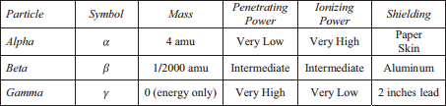
The ability of radiation to damage molecules is analyzed in terms of what is called ionizing power.
When a radiation particle interacts with atoms, the interaction can cause the atom to lose electrons and thus become ionized.
The greater the likelihood that damage will occur by an interaction is the ionizing power of the radiation.

Slide 27
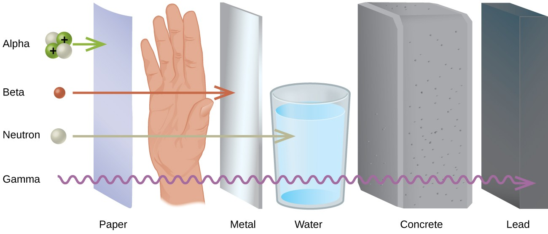
Penetrating Power of Radiation

Slide 28
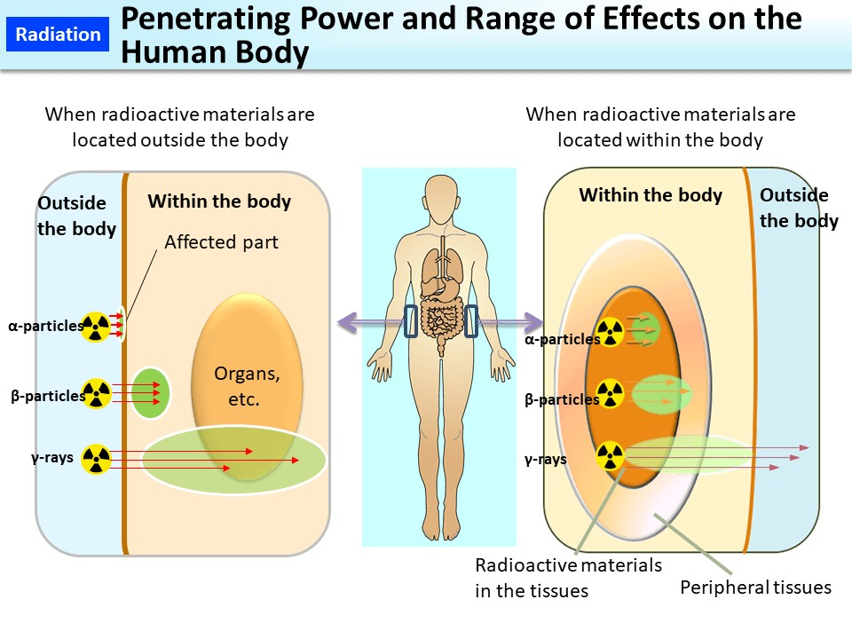
Range of Effects on the Human Body

Slide 29
Summary
Types of radiation differ in their ability to penetrate material and damage tissue, with alpha particles the least penetrating but potentially most damaging and gamma rays the most penetrating.
The two best ways to minimize exposure is to limit time of exposure and to increase distance from the source.

Slide 30
REFERENCE BOOKS:
Suraishkumar, Madhulika Dixit, Biology for Engineers and Non – Biologists, IIT Madras, Oxford University Press
Naren, Anubhav E, Vinay C, Mohsen G, ‘Electromagnetic Radiation Due to Cellular, Wi-Fi and Bluetooth Technologies: How Safe are we?’, IEEE Access Special section on Antenna Propagation for 5G and beyond, pp42980 - 43000, January 2020
Sapna E.T., India’s Organic Farming Revolution, University of Iowa Press, Iowa City, 2014

